Slide 1
Applied Cryptography Find-Preimage, Find-Second-Preimage, Find-Collision
Liangfeng Zhang
School of Information Science and Technology
ShanghaiTech University

Slide 2
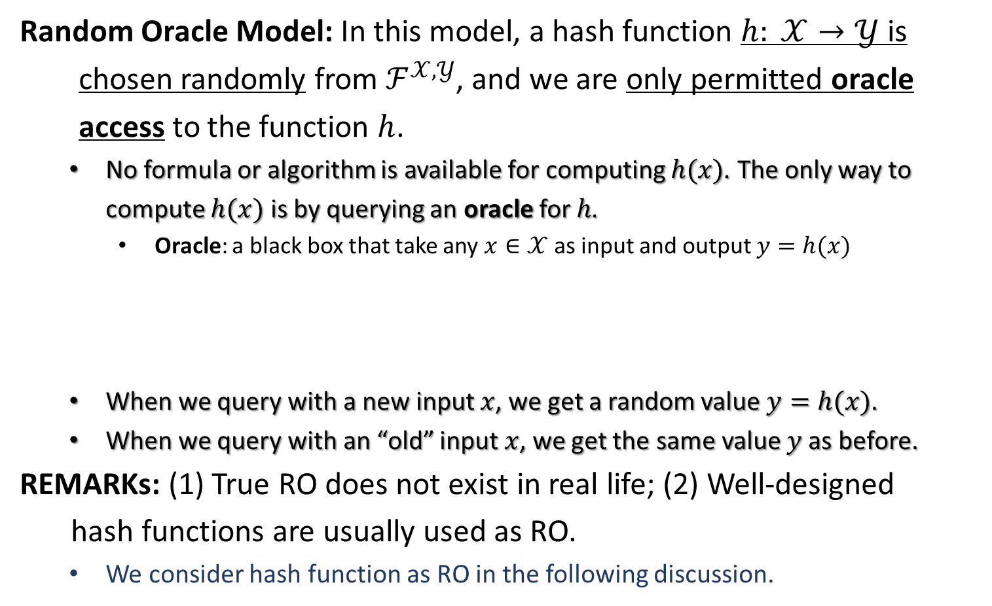



Random Oracle Model
Random Oracle Model: In this model, a hash function $h: 𝒳→𝒴$ is
chosen randomly from $ℱ^{𝒳,𝒴}$, and we are only permitted oracle
access to the function $h$.
No formula or algorithm is available for computing $h(x)$. The only way to compute $h(x)$ is by querying an oracle for $h$.
Oracle: a black box that take any $x∈𝒳$ as input and output $y=h(x)$
When we query with a new input $x$, we get a random value $y=h(x)$.
When we query with an “old” input $x$, we get the same value $y$as before.
REMARKs: (1) True RO does not exist in real life; (2) Well-designed
hash functions are usually used as RO.
We consider hash function as RO in the following discussion.
$$h(⋅)$$
$$h(x)$$
$$x$$
(The internal structure is not known!)

Slide 3
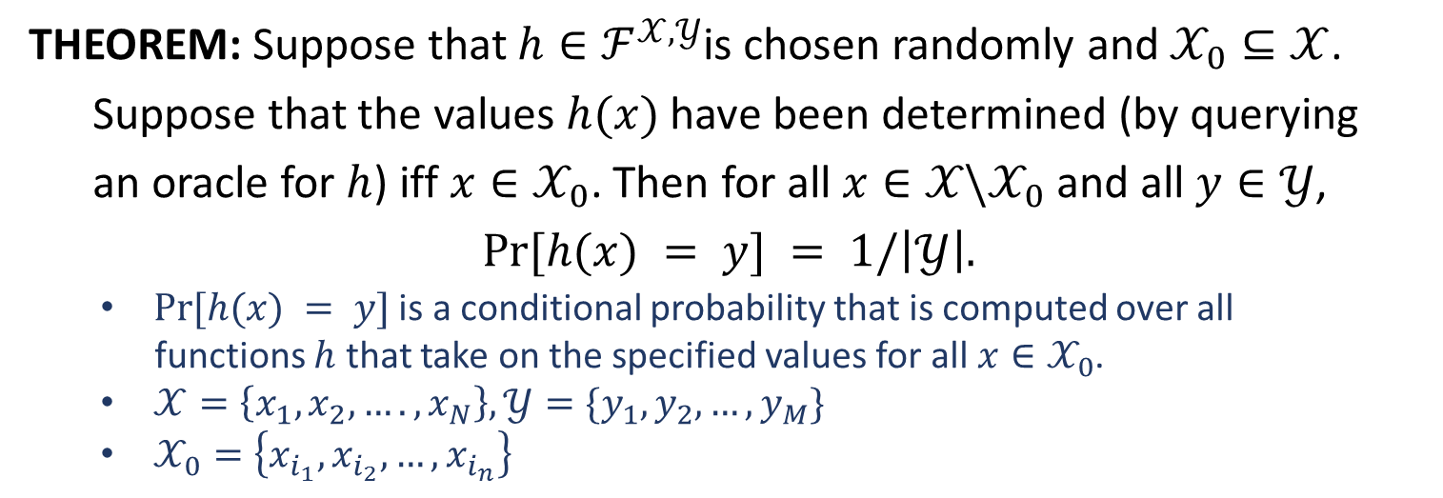
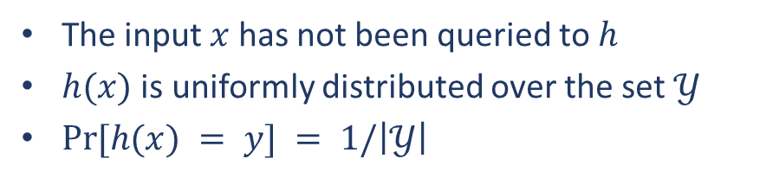
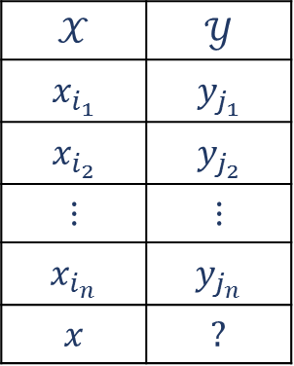
Random Oracle Model
THEOREM: Suppose that $h∈ℱ^{𝒳,𝒴}$is chosen randomly and $𝒳_{0}⊆𝒳$.
Suppose that the values $h(x)$ have been determined (by querying
an oracle for $h$) iff $x∈𝒳_{0}$. Then for all $x∈𝒳\backslash 𝒳_{0}$ and all $y∈𝒴$,
$$Pr⁡[h(x) = y] = 1/\left|𝒴\right|.$$
$Pr⁡[h(x) = y]$ is a conditional probability that is computed over all
functions $h$ that take on the specified values for all $x∈𝒳_{0}$.
$𝒳=\left\{x_{1},x_{2},….,x_{N}\right\}, 𝒴=\{y_{1},y_{2},…,y_{M}\}$
$𝒳_{0}=\left\{x_{i_{1}},x_{i_{2}},…,x_{i_{n}}\right\}$
$$𝒳$$ | $$𝒴$$
$$x_{i_{1}}$$ | $$y_{j_{1}}$$
$$x_{i_{2}}$$ | $$y_{j_{2}}$$
$$⋮$$ | $$⋮$$
$$x_{i_{n}}$$ | $$y_{j_{n}}$$
$$x$$ | $$?$$
The input $x$ has not been queried to $h$
$h(x)$ is uniformly distributed over the set $𝒴$
$Pr⁡[h(x) = y] = 1/\left|𝒴\right|$

Slide 4
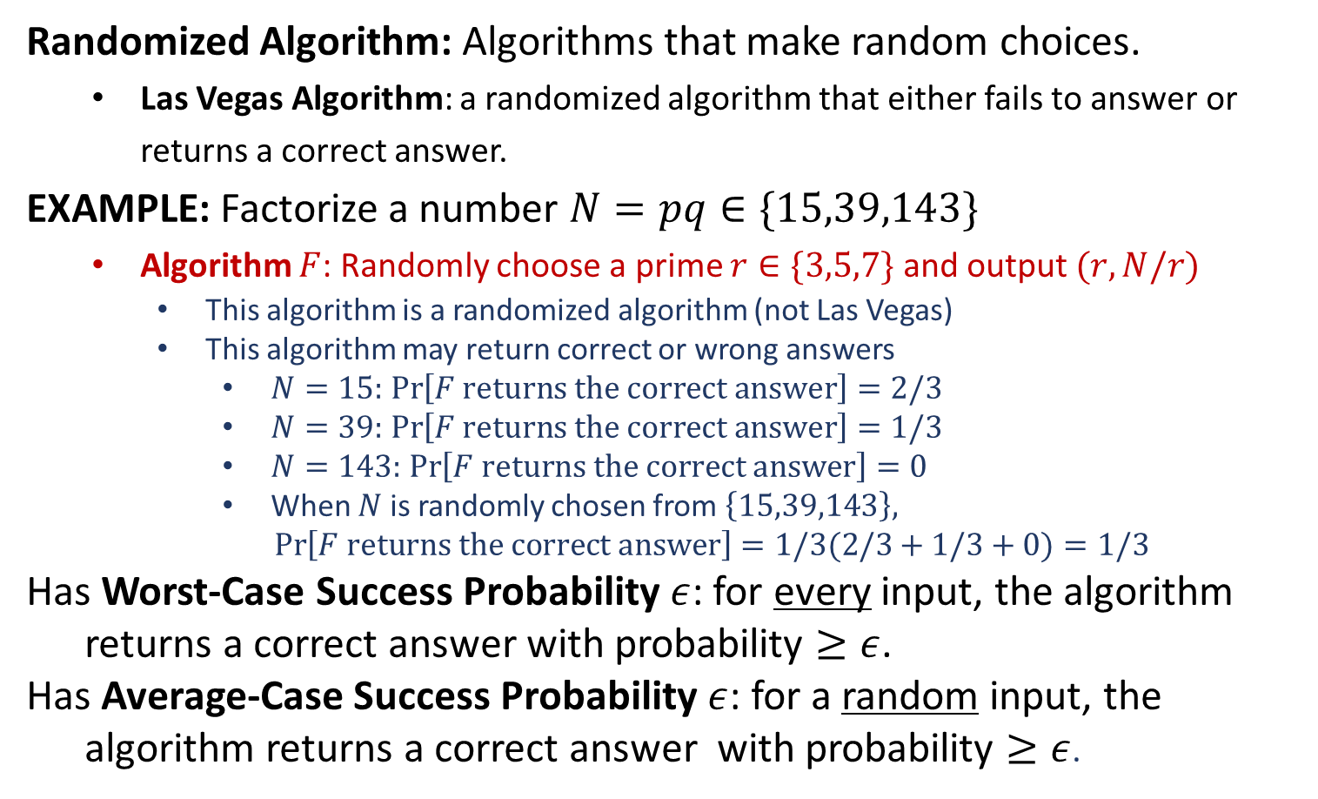
Algorithms in RO Model
Randomized Algorithm: Algorithms that make random choices.
Las Vegas Algorithm: a randomized algorithm that either fails to answer or returns a correct answer.
EXAMPLE: Factorize a number $N=pq∈\{15,39,143\}$
Algorithm $F$: Randomly choose a prime $r∈\{3,5,7\}$ and output $(r, N/r)$
This algorithm is a randomized algorithm (not Las Vegas)
This algorithm may return correct or wrong answers
$N=15:$ $\operatorname{Pr}\left[F returns the correct answer\right]=2/3$
$N=39:$ $\operatorname{Pr}\left[F returns the correct answer\right]=1/3$
$N=143:$ $\operatorname{Pr}\left[F returns the correct answer\right]=0$
When $N$ is randomly chosen from $\left\{15,39,143\right\},$
$\operatorname{Pr}\left[F returns the correct answer\right]=1/3(2/3+1/3+0)=1/3$
Has Worst-Case Success Probability $ε$: for every input, the algorithm
returns a correct answer with probability $≥ε$.
Has Average-Case Success Probability $ε$: for a random input, the
algorithm returns a correct answer with probability $≥ε$.

Slide 5

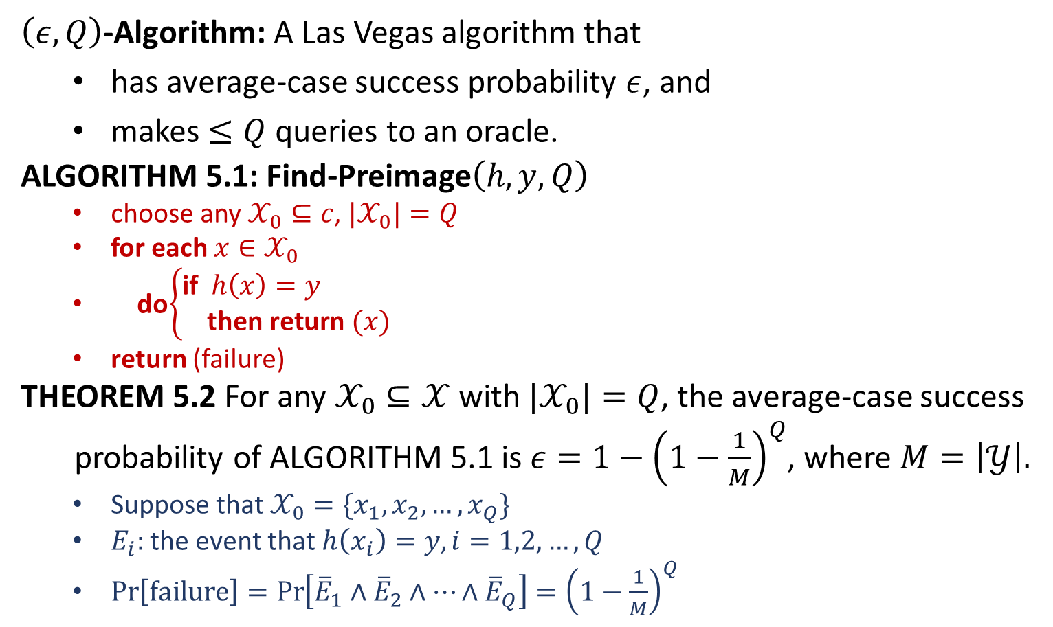
Algorithms in RO Model
$\left(ε,Q\right)$-Algorithm: A Las Vegas algorithm that
has average-case success probability $ε$, and
makes $≤Q$ queries to an oracle.
ALGORITHM 5.1: Find-Preimage$\left(h,y,Q\right)$
choose any $𝒳_{0}⊆c$, ${\text{|}𝒳}_{0}|=Q$
for each $x∈𝒳_{0}$
do$\left\{\begin{aligned}\text{if} h\left(x\right)=y \\ \text{then} \text{return} (x)\end{aligned}\right.$
return (failure)
THEOREM 5.2 For any $𝒳_{0}⊆𝒳$ with $|𝒳_{0}|=Q$, the average-case success
probability of ALGORITHM 5.1 is $ε=1−{\left(1−\frac{1}{M}\right)}^{Q}$, where $M=\left|𝒴\right|.$
Suppose that $𝒳_{0}=\{x_{1},x_{2},…,x_{Q}\}$
$E_{i}:$the event that $h\left(x_{i}\right)=y, i=1,2,…,Q$
$\operatorname{Pr}\left[failure\right]=\operatorname{Pr}\left[{\overline{E}}_{1}∧{\overline{E}}_{2}∧⋯∧{\overline{E}}_{Q}\right]={\left(1−\frac{1}{M}\right)}^{Q}$
$ε≈\frac{Q}{M}$ when $Q=o(M)$

Slide 6
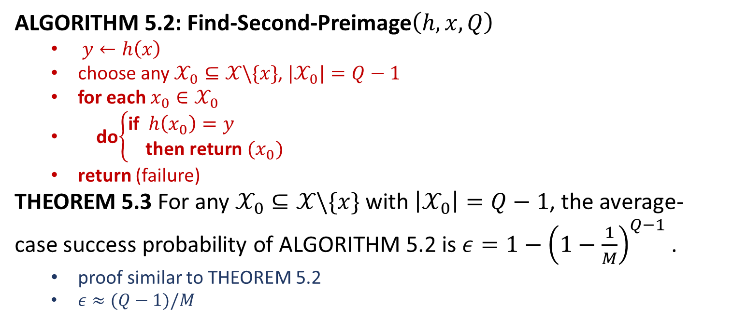
Algorithms in RO Model
ALGORITHM 5.2: Find-Second-Preimage$\left(h,x,Q\right)$
$y←h\left(x\right)$
choose any $𝒳_{0}⊆𝒳\backslash \{x\}$, ${\text{|}𝒳}_{0}|=Q−1$
for each $x_{0}∈𝒳_{0}$
do$\left\{\begin{aligned}\text{if} h\left(x_{0}\right)=y \\ \text{then} \text{return} (x_{0})\end{aligned}\right.$
return (failure)
THEOREM 5.3 For any $𝒳_{0}⊆𝒳\backslash \{x\}$ with $\left|𝒳_{0}\right|=Q−1$, the average-case success probability of ALGORITHM 5.2 is $ε=1−{\left(1−\frac{1}{M}\right)}^{Q−1}$ .
proof similar to THEOREM 5.2
$ε≈(Q−1)/M$

Slide 7
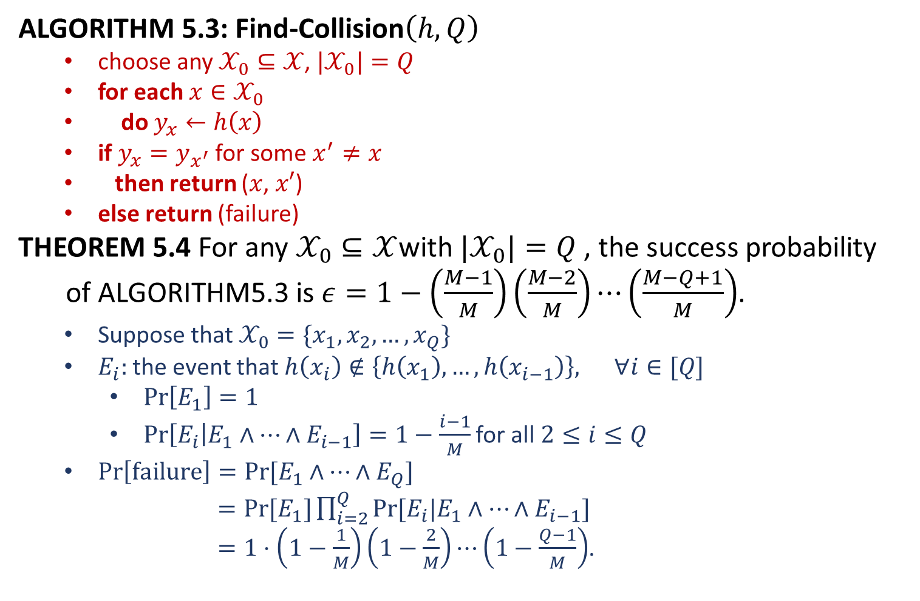
Algorithms in RO Model
ALGORITHM 5.3: Find-Collision$\left(h, Q\right)$
choose any $𝒳_{0}⊆𝒳$, ${\text{|}𝒳}_{0}|=Q$
for each $x∈𝒳_{0}$
do $y_{x}←h\left(x\right)$
if $y_{x}=y_{x^{′}}$ for some $x^{′}≠x$
then return ($x$, $x′$)
else return (failure)
THEOREM 5.4 For any $𝒳_{0}⊆𝒳$with ${\text{|}𝒳}_{0}|=Q$ , the success probability
of ALGORITHM5.3 is $ε=1−\left(\frac{M−1}{M}\right)\left(\frac{M−2}{M}\right)⋯\left(\frac{M−Q+1}{M}\right)$.
Suppose that $𝒳_{0}=\{x_{1},x_{2},…,x_{Q}\}$
$E_{i}:$the event that $h\left(x_{i}\right)∉\left\{h\left(x_{1}\right),…,h\left(x_{i−1}\right)\right\}, ∀i∈[Q]$
$\operatorname{Pr}\left[E_{1}\right]=1$
$\operatorname{Pr}\left[E_{i} | E_{1}∧⋯∧E_{i−1}\right]=1−\frac{i−1}{M}$ for all $2≤i≤Q$
$\operatorname{Pr}\left[failure\right]=Pr⁡[E_{1}∧⋯∧E_{Q}]$
$=Pr⁡[E_{1}]\prod_{i=2}^{Q}{Pr⁡[E_{i}|E_{1}∧⋯∧E_{i−1}]}$
$=1⋅\left(1−\frac{1}{M}\right)\left(1−\frac{2}{M}\right)⋯\left(1−\frac{Q−1}{M}\right)$.

Slide 8
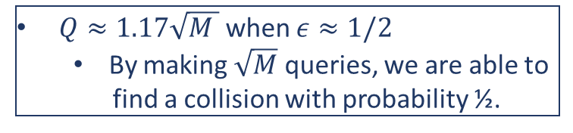
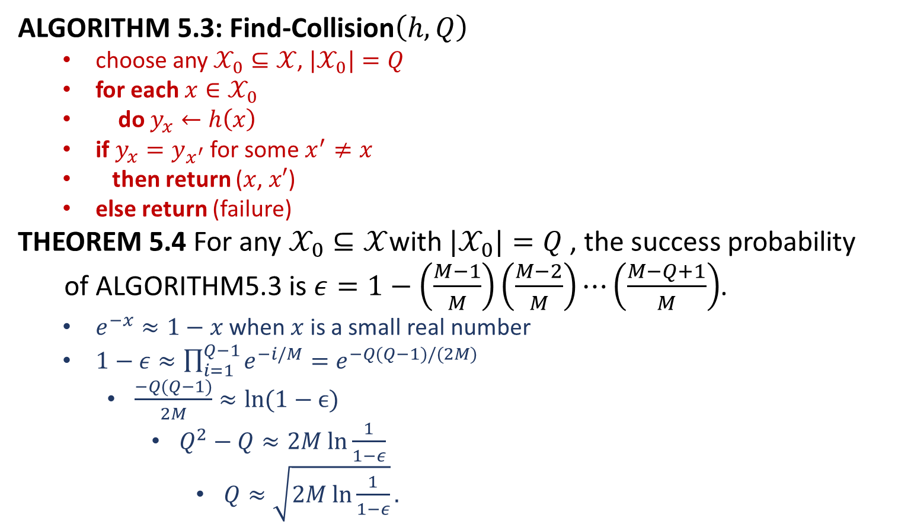


Algorithms in RO Model
ALGORITHM 5.3: Find-Collision$\left(h, Q\right)$
choose any $𝒳_{0}⊆𝒳$, ${\text{|}𝒳}_{0}|=Q$
for each $x∈𝒳_{0}$
do $y_{x}←h\left(x\right)$
if $y_{x}=y_{x^{′}}$ for some $x^{′}≠x$
then return ($x$, $x′$)
else return (failure)
THEOREM 5.4 For any $𝒳_{0}⊆𝒳$with ${\text{|}𝒳}_{0}|=Q$ , the success probability
of ALGORITHM5.3 is $ε=1−\left(\frac{M−1}{M}\right)\left(\frac{M−2}{M}\right)⋯\left(\frac{M−Q+1}{M}\right)$.
$e^{−x}≈1−x$ when $x$ is a small real number
$1−ε≈\prod_{i=1}^{Q−1}{e^{−i/M}}=e^{−Q(Q−1)/(2M)}$
$\frac{−Q(Q−1)}{2M}≈ln(1−ϵ)$
$Q^{2}−Q≈2M ln\frac{1}{1−ε}$
$Q≈\sqrt{2M ln\frac{1}{1−ε}}.$
Birthday Paradox
$Q≈23$ when $ε≈1/2$ and $M=365$
By randomly choosing 23 people, we
are able to find two persons having the
same birthday with probability ½.
$h\left(x\right)=$ the birthday of person $x$
$Q≈1.17\sqrt{M }$ when $ε≈1/2$
By making $\sqrt{M}$ queries, we are able to
find a collision with probability ½.
SHA-1: $M=2^{160}$
SHA-3: $2^{224}≤M≤2^{512}$

